Slide 1
Php language basics
Kodeeo Limited

Slide 2

Why PHP?
Runs on different platforms (Windows, Linux, Unix, Mac OS X, etc.)
PHP is compatible with almost all servers used today (Apache, IIS, etc.)
PHP has support for a wide range of databases
PHP is free. Download it from the official PHP resource: www.php.net
PHP is easy to learn and runs efficiently on the server side

Slide 3

Set Up PHP on Your Own PC
However, if your server does not support PHP, you must:
install a web server
install PHP
install a database, such as MySQL
The official PHP website (PHP.net) has installation instructions for PHP: http://php.net/manual/en/install.php

Slide 4

Basic PHP Syntax
A PHP script can be placed anywhere in the document.
A PHP script starts with <?php and ends with ?>
<?php //PHP code goes here ?>
The default file extension for PHP files is ".php".

Slide 5

php Comments
Single-line PHP Comments
Two forward slashes (//) followed by your comment text.
All text to the right of the // will be ignored.
//this line is for comment
N.B: You can also use a hash symbol (#) instead of //
#this line is for comment

Slide 6
Multiple lines comments
PHP supports 'C', style comments. A comment starts with the character pair /* and terminates with the character pair */.
/* This is a multiple comment testing,
and these lines will be ignored at the time of execution */

Slide 7

PHP echo and print Statements
echo "Hello";
Same as
echo("Hello");

Slide 8

Display Variables
$txt1 = "Learn PHP";
$txt2 = “Kodeeo Limited";
echo "$txt1";
echo "Study PHP at $txt2";
Using Single Quotes
$txt1 = "Learn PHP";
$txt2 = “Kodeeo Limited";
echo '<h2>' . $txt1 . '</h2>';
echo '<p>Study PHP at ' . $txt2 . '</p>';

Slide 9
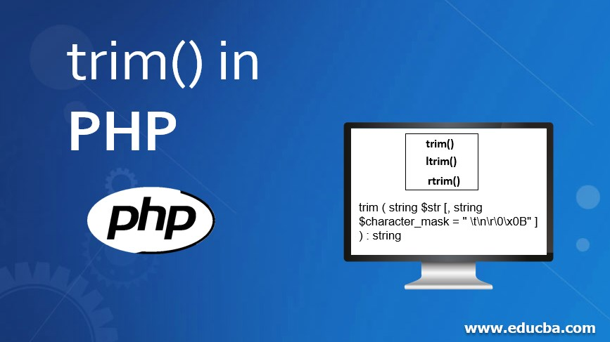
PHP trim() Function
In PHP, trim() is a built-in function that removes whitespace or other predefined characters from both the beginning and end of a string.

Slide 10
ltrim(): Removes characters only from the left (beginning) of the string.
rtrim(): Removes characters only from the right (end) of the string.

Slide 11
Thank You

